Slide 1




NEXT GEN EMPLOYABILITY PROGRAM
Creating a future-ready workforce
Team Members
College Name
Student Name : Vikhash T
Student ID : au711021104056
Info institute of engineering

Slide 2

CAPSTONE PROJECT SHOWCASE
Project Title
Notes Sharing Web Application using Django Framework
Abstract | Problem Statement | Project Overview | Proposed Solution | Technology Used | Modelling & Results | Conclusion

Slide 3
Abstract
In today's educational landscape, the capstone project serves as a culmination of students' academic endeavors, showcasing their acquired knowledge, skills, and creativity. To enhance the presentation and accessibility of these projects, the utilization of web development frameworks like Django proves to be instrumental. This abstract presents a comprehensive overview of leveraging Django for the efficient organization and presentation of capstone projects.
Django, a high-level Python web framework, provides a robust and scalable environment for building web applications. Its versatility and rich feature set make it an ideal choice for developing platforms to showcase capstone projects. By harnessing Django's MVC (Model-View-Controller) architecture, developers can structure and organize project data effectively.
Source :

Slide 4
Problem Statement
In academic institutions worldwide, the capstone project stands as a culmination of students academic journeys, encapsulating their knowledge, skills, and innovative endeavors. However, despite the significance of these projects, there exists a prevalent challenge in effectively showcasing them to a wider audience. Traditional methods of presentation, such as physical displays or static documents, limit the visibility and accessibility of capstone projects, hindering their potential impact and reach.
Source :

Slide 5
Project Overview
The capstone project showcase using django is a comprehensive web application designed to address the challenges associated with presenting and disseminating capstone projects in academic institutions. Leveraging the power of Django, a high-level Python web framework, this project aims to provide a centralized platform for students to showcase their capstone projects, fostering collaboration, visibility, and recognition within the academic community and beyond.
By providing a centralized, accessible, and user-friendly platform, this project aims to enhance the visibility, accessibility, and impact of students' capstone projects, fostering collaboration, recognition, and knowledge dissemination within the academic community and beyond
Source :

Slide 6
Proposed Solution
.
The proposed solution aims to develop a comprehensive capstone project showcase using django, a powerful web framework written in Python. This solution addresses the challenges faced by academic institutions in effectively presenting and disseminating capstone projects. By leveraging Django's features and flexibility, the solution provides a centralized platform for students to showcase their projects, enhancing visibility, accessibility, and collaboration within the academic community. By leveraging Django's features for user authentication, dynamic content rendering, collaboration, and scalability, the solution aims to enhance the visibility, accessibility, and impact of students' capstone projects, fostering collaboration, recognition, and knowledge dissemination within the academic community.
Source :

Slide 7
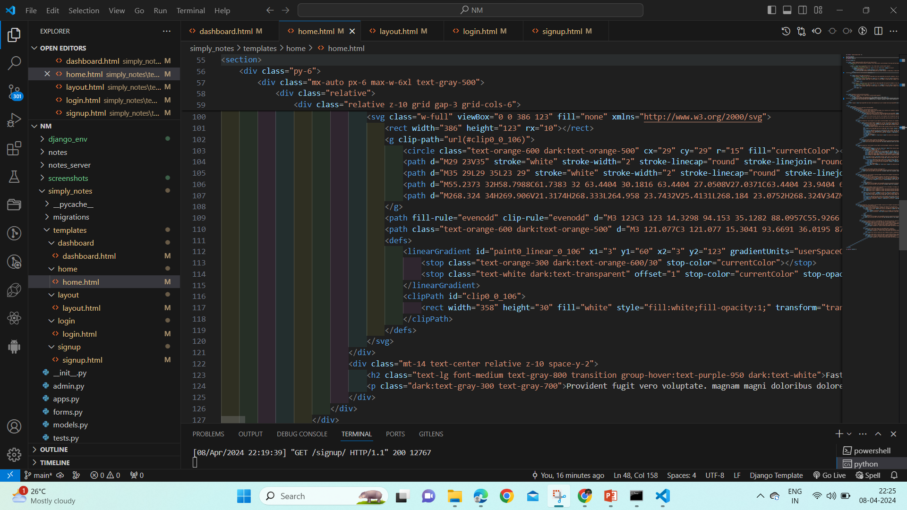
Source :

Slide 8
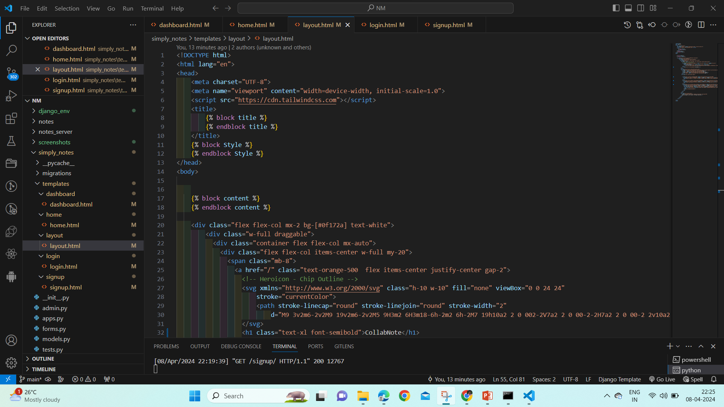
Source :

Slide 9


Technology Used
Front-end
Back-end
Source :

Slide 10
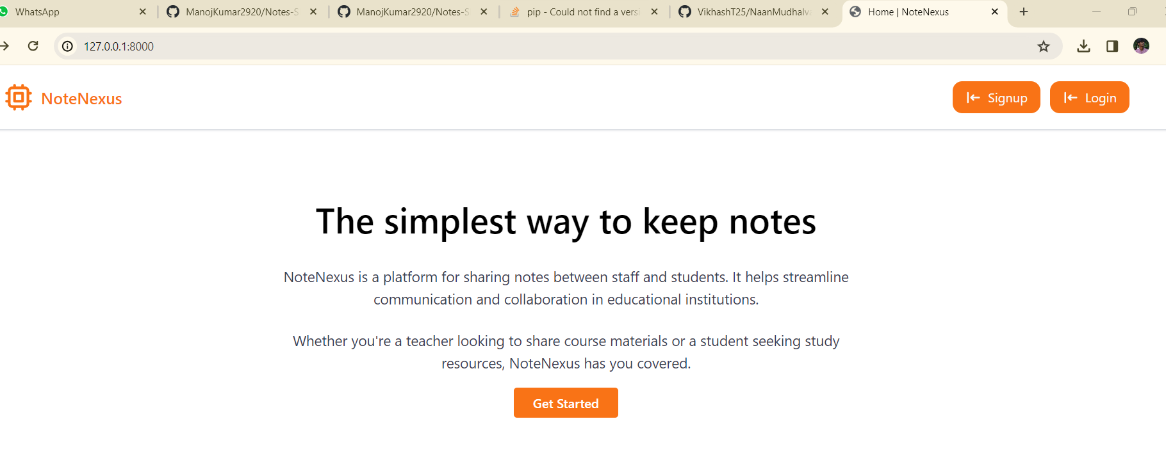
Modelling & Results
Source :

Slide 11
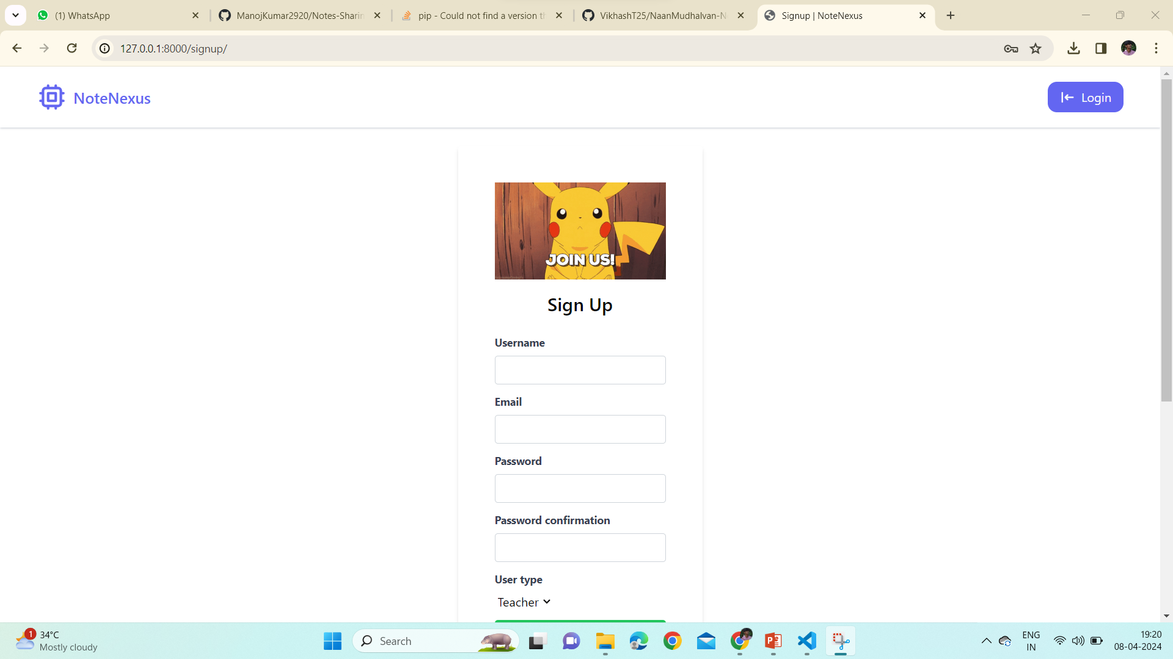
Sign-up-Page

Slide 12
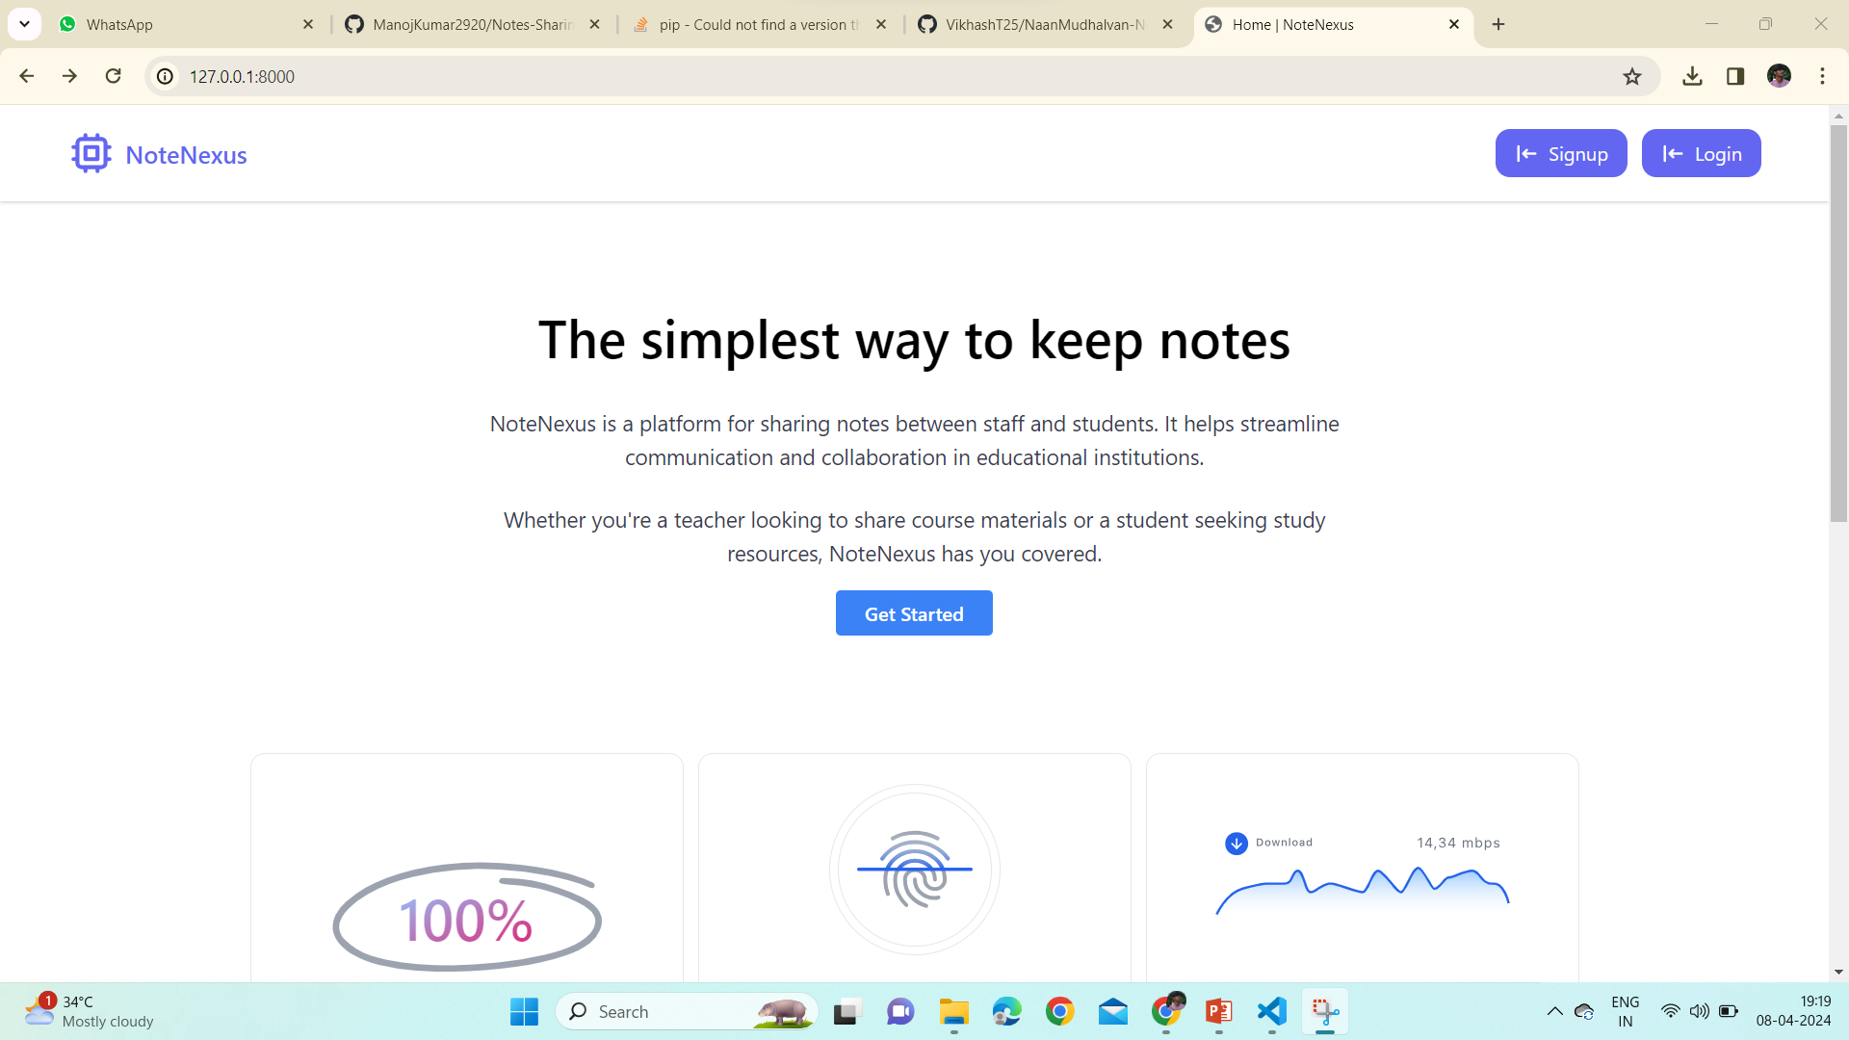
Home-Page

Slide 13
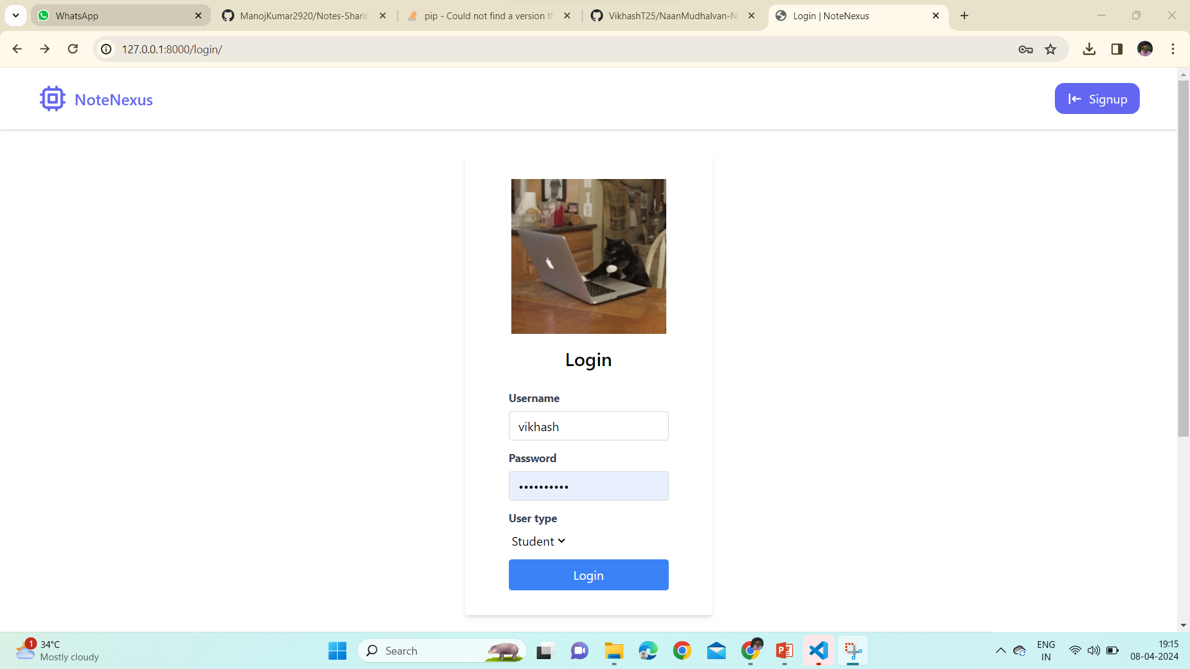
Login-Page

Slide 14
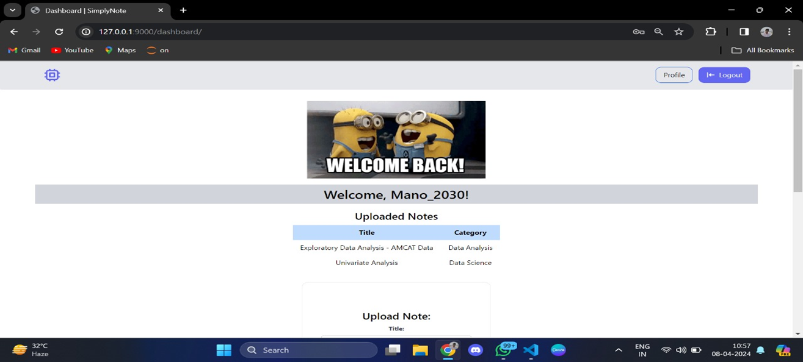
Dashboard-Page

Slide 15
Future Enhancements:
The integration of machine learning for project recommendation represents a promising future enhancement for the capstone project showcase using django. By leveraging user behavior analysis, project content analysis, and recommendation algorithms, this enhancement aims to deliver personalized project suggestions that enhance user engagement, discovery, and learning outcomes. As the platform evolves, continuous learning and improvement mechanisms will ensure that recommendations remain relevant, diverse, and aligned with users' interests and objectives, thereby enriching the overall user experience and promoting knowledge dissemination within the academic community.

Slide 16
Conclusion
In conclusion, the Capstone Project Showcase utilizing Django has been a testament to the culmination of our skills, creativity, and dedication throughout this journey. Through the development of dynamic web applications, we have not only honed our technical expertise but also demonstrated our ability to solve real-world problems with innovative solutions. The projects showcased here represent the embodiment of our learning experience, showcasing our ability to leverage Django's powerful features to create robust, user-friendly applications. As we move forward, we carry with us the invaluable lessons learned and the confidence gained, ready to embark on new challenges and continue making meaningful contributions to the world of web development.
Source :

Slide 17
Thank You!
Notes:
Thank You !!

